Slide 1
AVR Microcontroller
Microprocessor Course
Chapter 10
AVR INTERRUPT PROGRAMMING
IN ASSEMBLY AND C
Day 1401(version 1.3)

Slide 2
AVR INTERRUPT PROGRAMMING In ASSEMBLY AND C 10.1 AVR INTERRUPT
Interrupts vs. polling
There are two methods by which devices receive service from the microcontroller: interrupts or polling.
In the interrupt method, whenever any device needs the microcontroller's service, the device notifies it by sending an interrupt signal. Upon receiving an interrupt signal, the microcontroller stops whatever it is doing and serves the device. The program associated with the interrupt is called the Interrupt service routine (ISR) or interrupt handler.
In the polling method, the microcontroller continuously monitors the status of a given device; when the status condition is met, it performs the service. After that, it moves on to monitor the next device until each one is serviced.
Notes:
The advantage of interrupts is that the microcontroller can serve many devices; each device can get the attention of the microcontroller based on the priority assigned to it.
The polling method cannot assign priority because it checks all devices in a round-robin fashion.
More importantly, in the interrupt method the microcontroller can also ignore (mask) a device request for service. This also is not possible with the polling method.
The most important reason that the interrupt method is preferable is that the polling method wastes much of the microcontroller's time by polling devices that do not need service. So interrupts are used to avoid tying down the microcontroller.

Slide 3
AVR INTERRUPT PROGRAMMING In ASSEMBLY AND C 10.1 AVR INTERRUPT
Interrupt Service Routine (ISR)
For every interrupt, there must be an interrupt service routine (ISR), or interrupt handler. When an interrupt is invoked, the microcontroller runs the interrupt service routine. Generally, in most microprocessors, for every interrupt there is a fixed location in memory that holds the address of its ISR.
Interrupt Vector Table (IVT)
The group of memory locations set aside to hold the addresses of ISRs is called the Interrupt Vector Table (IVT).

Slide 4
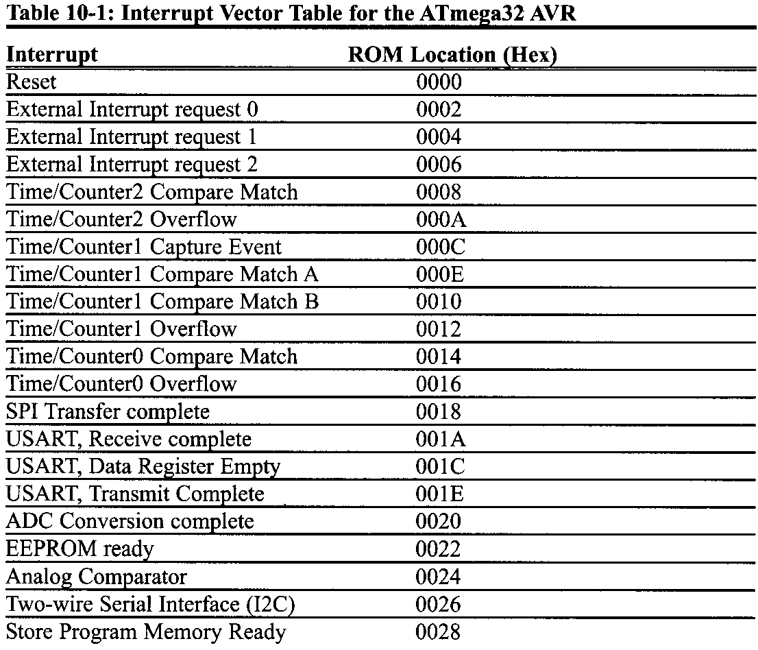
AVR INTERRUPT PROGRAMMING In ASSEMBLY AND C 10.1 AVR INTERRUPT

Slide 5
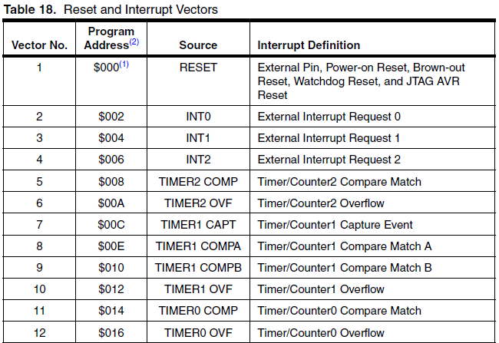
AVR INTERRUPT PROGRAMMING In ASSEMBLY AND C 10.1 AVR INTERRUPT

Slide 6
AVR INTERRUPT PROGRAMMING In ASSEMBLY AND C 10.1 AVR INTERRUPT
Steps in executing an interrupt
Upon activation of an interrupt, the microcontroller goes through the following steps:
It finishes the instruction it is currently executing and saves the address of the next instruction (program counter) on the stack.
It jumps to a fixed location in memory called the interrupt vector table. The interrupt vector table directs the microcontroller to the address of the interrupt service routine (ISR).
The microcontroller starts to execute the interrupt service subroutine until it reaches the last instruction of the subroutine, which is RETI (return from interrupt).
Upon executing the RETI instruction, the microcontroller returns to the place where it was interrupted.

Slide 7
AVR INTERRUPT PROGRAMMING In ASSEMBLY AND C 10.1 AVR INTERRUPT
Sources of interrupts in the AVR
There are many sources of interrupts in the AVR, depending on which peripheral is incorporated into the chip. The following are some of the most widely used sources of interrupts in the AVR:
There are at least two interrupts set aside for each of the timers, one for overflow and another for compare match.
Three interrupts are set aside for external hardware interrupts. Pins PD2 (PORTD.2), PD3 (PORTD.3), and PB2 (PORTB.2) are for the external hardware interrupts INT0, INT1, and INT2, respectively.
Serial communication's USART has three interrupts, one for receive and two interrupts for transmit.
The SPI interrupts.
The ADC (analog-to-digital converter).

Slide 8
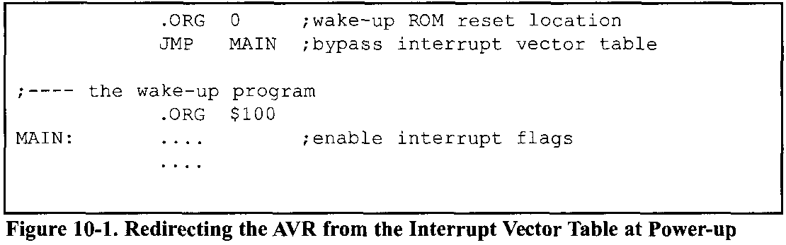
AVR INTERRUPT PROGRAMMING In ASSEMBLY AND C 10.1 AVR INTERRUPT
The AVR has many more interrupts than the list shows. Notice in Table 10-1. that a limited number of bytes is set aside for interrupts. For example, a total of 2 words (4 bytes), from locations 0016 to 0018, are set aside for Timer0 overflow interrupt. Normally, the service routine for an interrupt is too long to fit into the memory space allocated. For that reason, a JMP instruction is placed in the vector table to point to the address of the ISR.

Slide 9
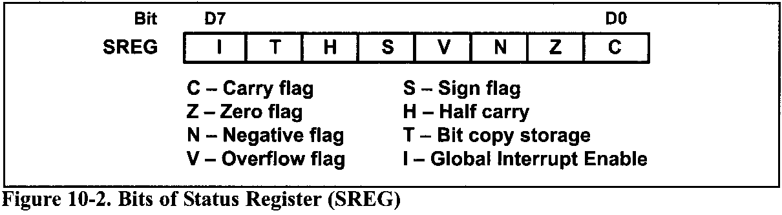
AVR INTERRUPT PROGRAMMING In ASSEMBLY AND C 10.1 AVR INTERRUPT
Enabling and disabling an interrupt
Upon reset, all interrupts are disabled (masked), The interrupts must be enabled (unmasked) by software in order for the microcontroller to respond to them. The D7 bit of the SREG (Status Register) register is responsible for enabling and disabling the interrupts globally. The I bit makes the job of disabling all the interrupts easy. With a single instruction "CLI" (Clear Interrupt), we can make I = 0 during the operation of a critical task.

Slide 10
AVR INTERRUPT PROGRAMMING In ASSEMBLY AND C 10.1 AVR INTERRUPT
Steps in enabling an interrupt
To enable any one of the interrupts, we take the following steps:
Bit D7 (I) of the SREG register must be set to HIGH to allow the interrupts to happen. This is done with the "SEI" (Set Interrupt) instruction.
If I = 1, each interrupt is enabled by setting to HIGH the interrupt enable (IE) flag bit for that interrupt. There are some I/O registers holding the interrupt enable bits. Figure 10-3 shows that the TIMSK register has interrupt enable bits for Timed, Timer1, and Timer2. It must be noted that if I = 0, no interrupt will be responded to, even if the corresponding interrupt enable bit is high.

Slide 11
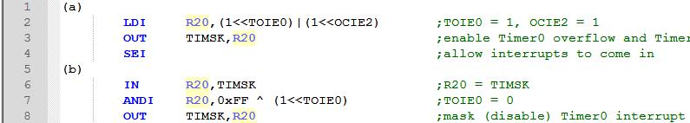

AVR INTERRUPT PROGRAMMING In ASSEMBLY AND C 10.1 AVR INTERRUPT
Example 10-1
Show the instructions to
enable (unmask) the Timer0 overflow interrupt and Timer2 compare match interrupt, and
disable (mask) the Timer0 overflow interrupt, then
show how to disable (mask) all the interrupts with a single instruction.
Solution:
We can perform the above actions with the following instructions, as well:

Slide 12

AVR INTERRUPT PROGRAMMING In ASSEMBLY AND C 10.1 AVR INTERRUPT
Bit 2 – TOIE1: Timer/Counter1, Overflow Interrupt Enable
When this bit is written to one, and the I-flag in the Status Register is set (interrupts globally enabled), the Timer/Counter1 Overflow Interrupt is enabled. The corresponding Interrupt Vector is executed when the TOV1 Flag, located in TIFR, is set.
Bit 4 – OCIE1A: Timer/Counter1, Output Compare A Match Interrupt Enable
When this bit is written to one, and the I-flag in the Status Register is set (interrupts globally enabled), the Timer/Counter1 Output Compare A match interrupt is enabled. The corresponding Interrupt Vector is executed when the OCF1A Flag, located in TIFR, is set.

Slide 13
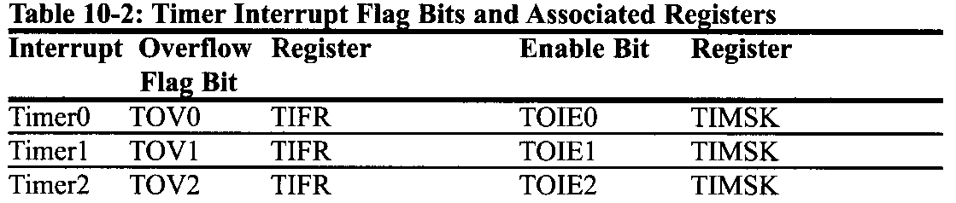
AVR INTERRUPT PROGRAMMING In ASSEMBLY AND C 10.2 PROGRAMMING TIMER INTERRUPTS
Rollover timer flag and interrupt
In polling TOV0, we have to wait until TOV0 is raised.
Using interrupts avoids tying down the controller. If the timer interrupt in the interrupt register is enabled, TOV0 is raised whenever the timer rolls over and the microcontroller jumps to the interrupt vector table to service the ISR. In this way, the microcontroller can do other things until it is notified that the timer has rolled over.
The TOIEx bit enables the interrupt for a given timer. TOIEx bits are held by the TIMSK register.

Slide 14
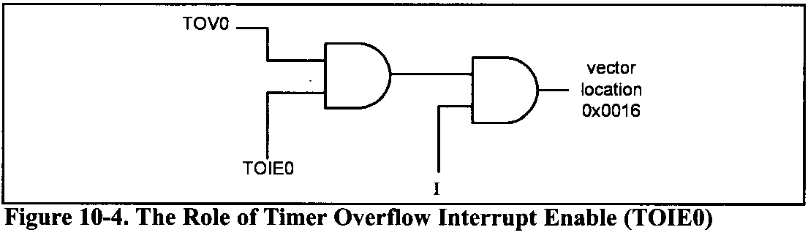
AVR INTERRUPT PROGRAMMING In ASSEMBLY AND C 10.2 PROGRAMMING TIMER INTERRUPTS

Slide 15
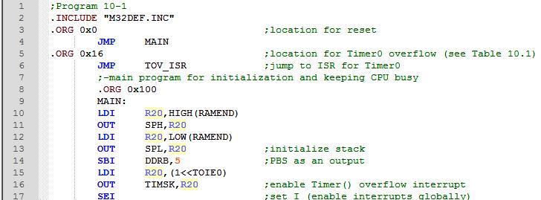
AVR INTERRUPT PROGRAMMING In ASSEMBLY AND C 10.2 PROGRAMMING TIMER INTERRUPTS
Program 10-1:
For this program, we assume that PORTC is connected to 8 switches and PORTD to 8 LEDs. This program uses Timer0 to generate a square wave on pin PORTB.5, while at the same time data is being transferred from PORTC to PORTD.

Slide 16
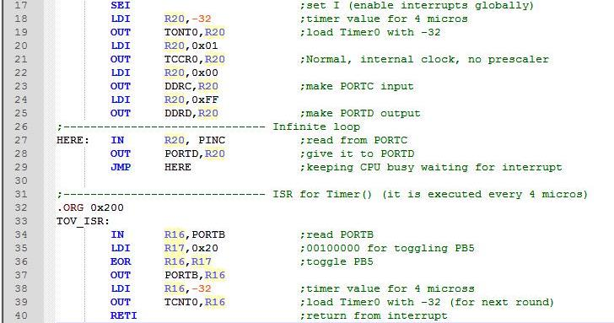
AVR INTERRUPT PROGRAMMING In ASSEMBLY AND C 10.2 PROGRAMMING TIMER INTERRUPTS

Slide 17
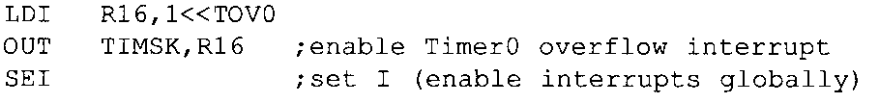
AVR INTERRUPT PROGRAMMING In ASSEMBLY AND C 10.2 PROGRAMMING TIMER INTERRUPTS
Notice the following points about Program 10- 1:
We must avoid using the memory space allocated to the interrupt vector table. Therefore, we place all the initialization codes in memory starting at an address such as $100. The JMP instruction is the first instruction that the AVR executes when it is awakened at address 0000 upon reset. The JMP instruction at address 0000 redirects the controller away from the interrupt vector table.
In the MAIN program, we enable (unmask) the Timer0 interrupt with the following instructions:
In the MAIN program, we initialize the Timer0 register and then enter into an infinite loop to keep the CPU busy. The loop could be replaced with a real world application being executed by the CPU. The TOIE0 flag is raised as soon as Timer0 rolls over, and the microcontroller gets out of the loop and goes to $0016 to execute the ISR associated with Timer0. At this point, the AVR clears the I bit (D7 of SREG) to indicate that it is currently serving an interrupt and cannot be interrupted again.

Slide 18
AVR INTERRUPT PROGRAMMING In ASSEMBLY AND C 10.2 PROGRAMMING TIMER INTERRUPTS
The ISR for Timer0 is located starting at memory location $200 because it is too large to fit into address space $16-$18, the address allocated to the Timer0 overflow interrupt in the interrupt vector table.
RETI must be the last instruction of the ISR. Upon execution of the RETI instruction, the AVR automatically enables the I bit (D7 of the SREG register) to indicate that it can accept new interrupts.
In the ISR for Timer0, notice that there is no need for clearing the TOV0 flag since the AVR clears the TOV0 flag internally upon jumping to the interrupt vector table.

Slide 19
AVR INTERRUPT PROGRAMMING In ASSEMBLY AND C 10.2 PROGRAMMING TIMER INTERRUPTS
Example 10-2
What is the difference between the RET and RETI instructions? Explain why we can-not use RET instead of RETI as the last instruction of an ISR.
Solution:
Both perform the same actions of popping off the top bytes of the stack into the program counter, and making the AVR return to where it left off. However, RETI also performs the additional task of setting the I flag, indicating that the servicing of the interrupt is over and the AVR now can accept a new interrupt. If you use RET instead of RETI as the last instruction of the interrupt service routine, you simply block any new interrupt after the first interrupt, because the I would indicate that the interrupt is still being serviced.

Slide 20
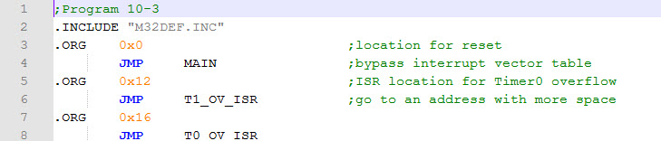
AVR INTERRUPT PROGRAMMING In ASSEMBLY AND C 10.2 PROGRAMMING TIMER INTERRUPTS
Program 10-2 uses Timer0 and Timer1 interrupts simultaneously, to generate square waves on pins PB1 and PB7 respectively, while data is being transferred from PORTC to PORTD.

Slide 21
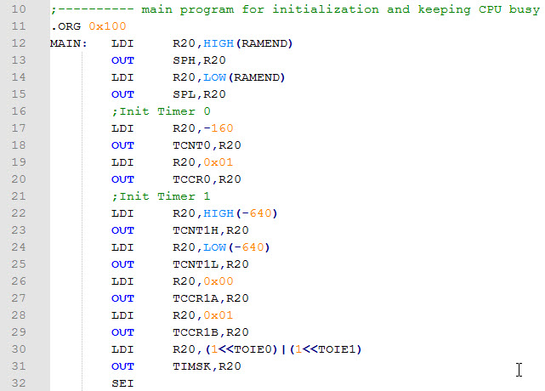
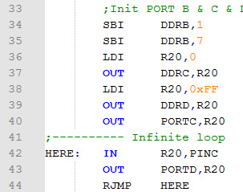
AVR INTERRUPT PROGRAMMING In ASSEMBLY AND C 10.2 PROGRAMMING TIMER INTERRUPTS

Slide 22
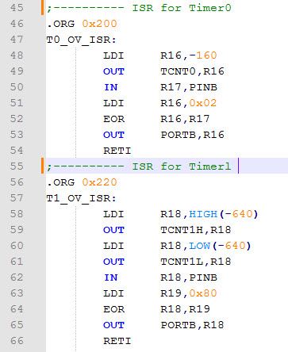
AVR INTERRUPT PROGRAMMING In ASSEMBLY AND C 10.2 PROGRAMMING TIMER INTERRUPTS

Slide 23
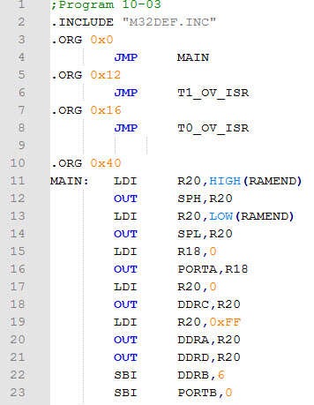
AVR INTERRUPT PROGRAMMING In ASSEMBLY AND C 10.2 PROGRAMMING TIMER INTERRUPTS
Program 10-3 has two interrupts:
PORTA counts up every time Timer1 overflows. It overflows once per second.
A pulse is fed into Timer0, where Timer0 is used as counter and counts up. Whenever the counter reaches 200, it will toggle the pin PORTB.6.

Slide 24
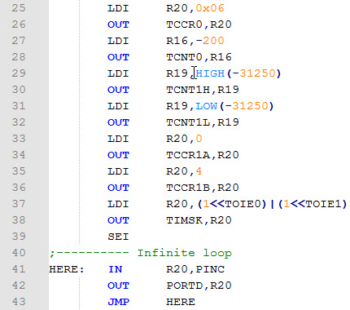
AVR INTERRUPT PROGRAMMING In ASSEMBLY AND C 10.2 PROGRAMMING TIMER INTERRUPTS

Slide 25
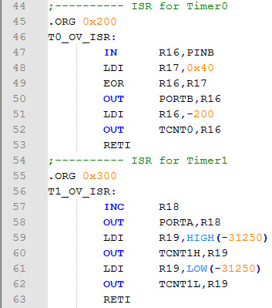
AVR INTERRUPT PROGRAMMING In ASSEMBLY AND C 10.2 PROGRAMMING TIMER INTERRUPTS

Slide 26
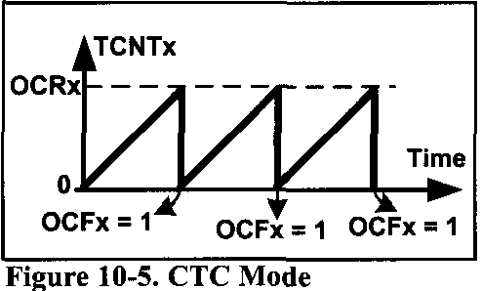
AVR INTERRUPT PROGRAMMING In ASSEMBLY AND C 10.2 PROGRAMMING TIMER INTERRUPTS
Compare match timer flag and interrupt
Sometimes a task should be done periodically, as in the previous examples. The programs can be written using the CTC mode and compare match (OCF) flag. To do so, we load the OCR register with the proper value and initialize the timer to the CTC mode. When the content of TCNT matches with OCR, the OCF flag is set, which causes the compare match interrupt to occur.

Slide 27
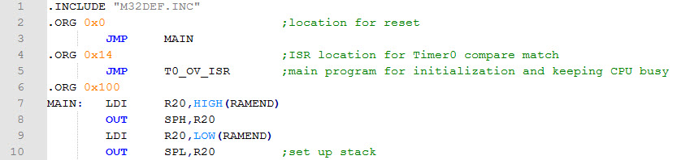
AVR INTERRUPT PROGRAMMING In ASSEMBLY AND C 10.2 PROGRAMMING TIMER INTERRUPTS
Example 10-3
Using Timer0, write a program that toggles pin PORTB.5 every 40 us, while at the same time transferring data from PORTC to PORTD. Assume XTAL = 1 MHz.
Solution:
1/1 MHz = 1 us and 40 us/1 us = 40.
That means we must have OCR0 = 40 - 1 = 39

Slide 28
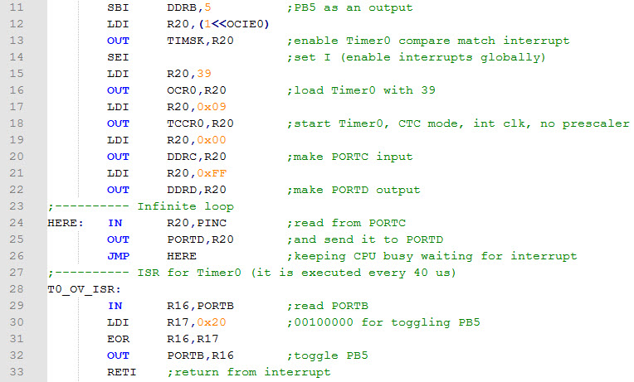
AVR INTERRUPT PROGRAMMING In ASSEMBLY AND C 10.2 PROGRAMMING TIMER INTERRUPTS

Slide 29
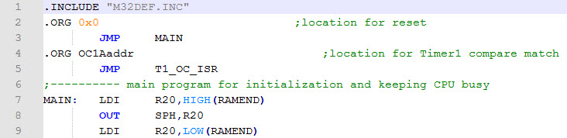
AVR INTERRUPT PROGRAMMING In ASSEMBLY AND C 10.2 PROGRAMMING TIMER INTERRUPTS
Example 10-4
Using Timer1, write a program that toggles pin PORTB.5 every second, while at the same time transferring data from PORTC to PORTD. Assume XTAL = 8 MHz.
Solution:
For prescaler = 1024 we have T_{clock}= (1/8 MHz) × 1024 = 128 µs and
1s/128 µs = 7812. That means we must have OCR1A = 7811 = 0x1E83

Slide 30
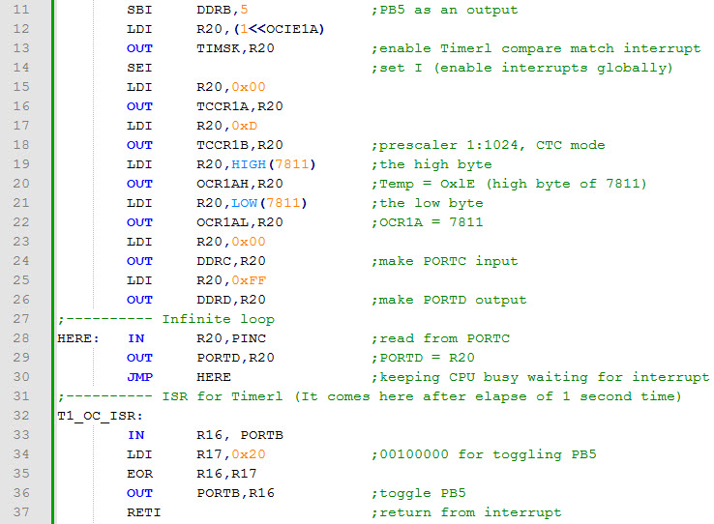
AVR INTERRUPT PROGRAMMING In ASSEMBLY AND C 10.2 PROGRAMMING TIMER INTERRUPTS

Slide 31
AVR INTERRUPT PROGRAMMING In ASSEMBLY AND C 10.3 PROGRAMMING EXTERNAL HARDWARE INTERRUPTS
The number of external hardware interrupt interrupts varies in different AVRs. The ATmega32 has three external hardware interrupts:
Pin PD2 (PORTD.2), INT0 ----- Vector location 0x02
Pin PD3 (PORTD.3), INT1 ----- Vector location 0x04
Pin PB2 (PORTB.2), INT2 ----- Vector location 0x06
Upon activation of these pins, the AVR is interrupted in whatever it is doing and jumps to the vector table to perform the interrupt service routine.
The hardware interrupts must be enabled before they can take effect. This is done using the INTx bit located in the GICR register.
For example, the following instructions enable INT0:

Slide 32
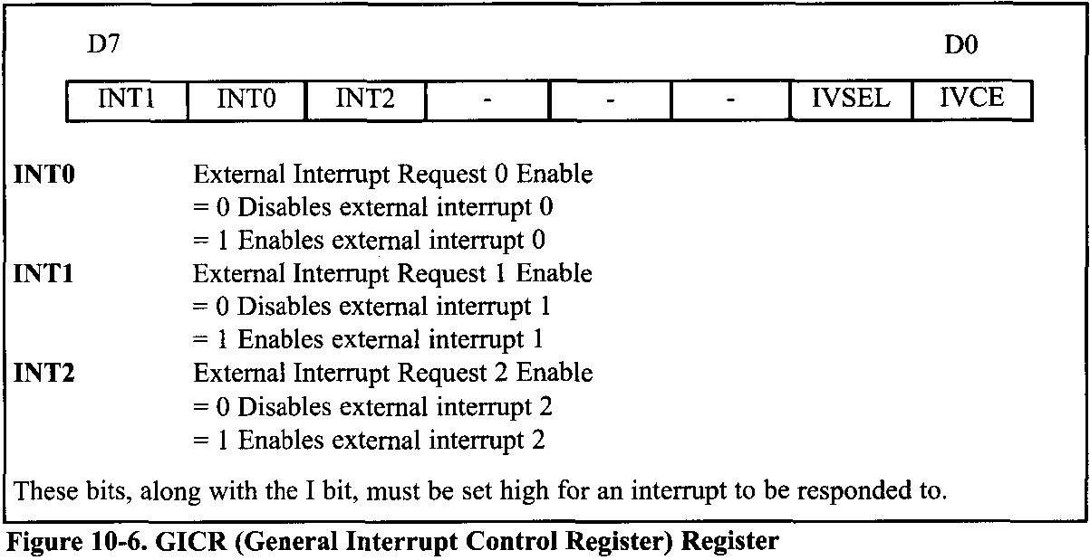
AVR INTERRUPT PROGRAMMING In ASSEMBLY AND C 10.3 PROGRAMMING EXTERNAL HARDWARE INTERRUPTS

Slide 33
AVR INTERRUPT PROGRAMMING In ASSEMBLY AND C 10.3 PROGRAMMING EXTERNAL HARDWARE INTERRUPTS
The INT0 is a low-level-triggered interrupt by default, which means, when a low signal is applied to pin PD2 (PORTD.2), the controller will be interrupted and jump to location $0002 in the vector table to service the ISR.
In this program, the microcontroller is looping continuously in the HERE loop. Whenever the switch on INT0 (pin PD2) is activated, the microcontroller gets out of the loop and jumps to vector location $0002. The ISR for INT0 toggles the PC0. If, by the time it executes the RETI instruction, the INT0 pin is still low, the microcontroller initiates the interrupt again. Therefore, if we want the ISR to be executed once, the INT0 pin must be brought back to high before RETI is executed, or we should make the interrupt edge-triggered.

Slide 34
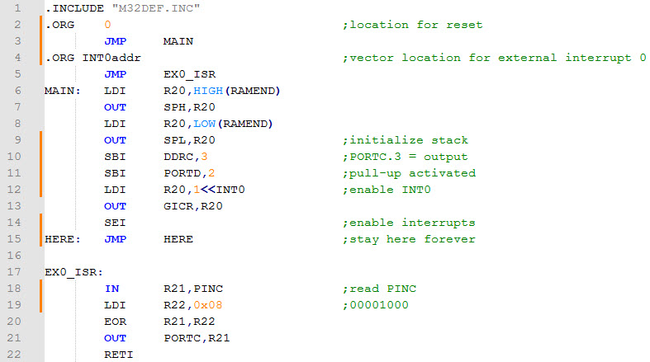
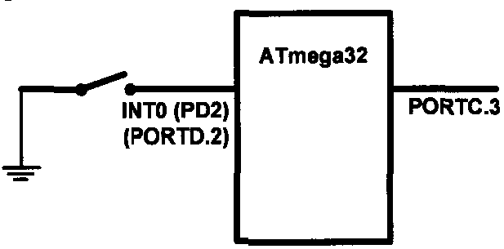
AVR INTERRUPT PROGRAMMING In ASSEMBLY AND C 10.3 PROGRAMMING EXTERNAL HARDWARE INTERRUPTS
Example 10-5
Assume that the INT0 pin is connected to a switch that is normally high. Write a program that toggles PORTC.3 whenever the INT0 pin goes low.

Slide 35
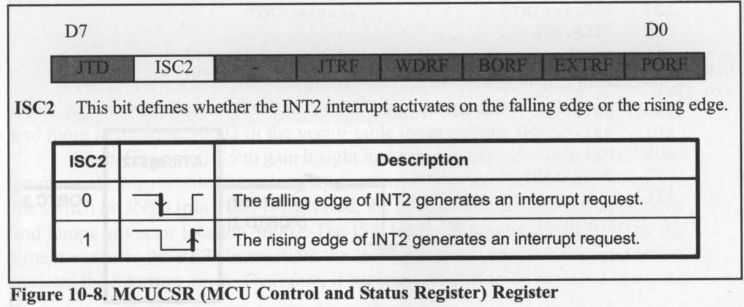
AVR INTERRUPT PROGRAMMING In ASSEMBLY AND C 10.3 PROGRAMMING EXTERNAL HARDWARE INTERRUPTS
Edge-triggered vs. level-triggered interrupts
There are two types of activation for the external hardware interrupts:
level triggered, INT0 and INT1 can be level or edge triggered.
edge triggered, INT2 is only edge triggered,
As stated before, upon reset INT0 and INT1 are low-level-triggered interrupts. The bits of the MCUCR register indicate the trigger options of INT0 and INT1.

Slide 36
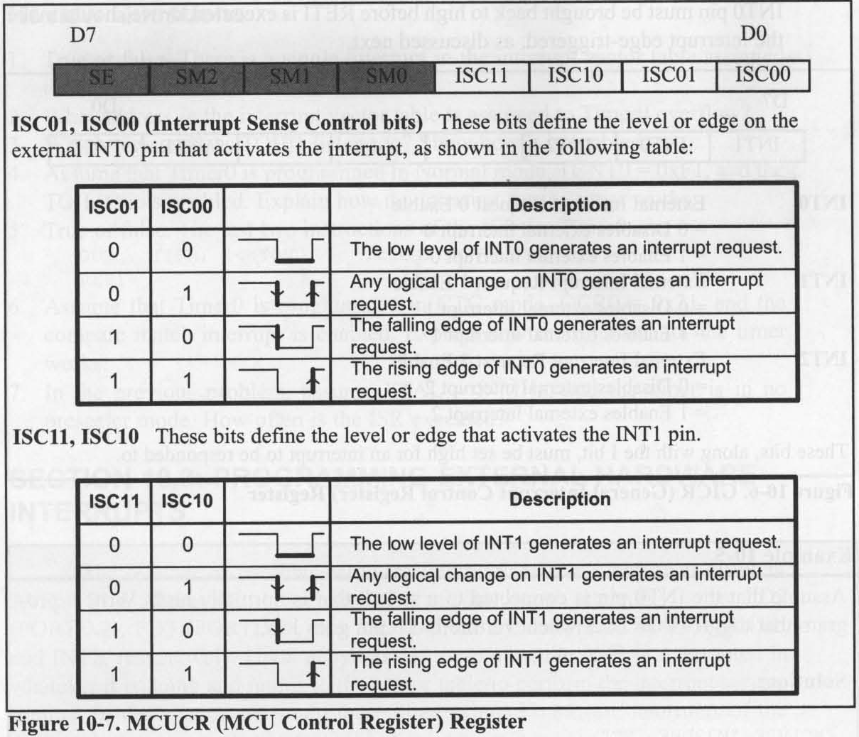
AVR INTERRUPT PROGRAMMING In ASSEMBLY AND C 10.3 PROGRAMMING EXTERNAL HARDWARE INTERRUPTS

Slide 37
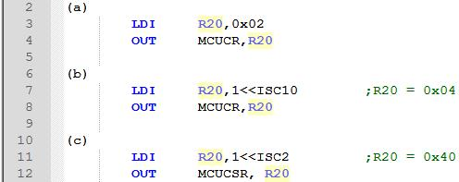
AVR INTERRUPT PROGRAMMING In ASSEMBLY AND C 10.3 PROGRAMMING EXTERNAL HARDWARE INTERRUPTS
Example 10-6
Show the instructions to
make INT0 falling edge triggered,
make INT1 triggered on any change, and
make INT2 rising edge triggered.
Solution:

Slide 38
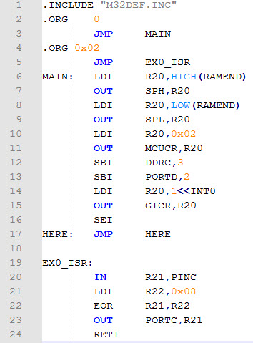
AVR INTERRUPT PROGRAMMING In ASSEMBLY AND C 10.3 PROGRAMMING EXTERNAL HARDWARE INTERRUPTS
Example 10-7
Rewrite Example 10-5, so that whenever INT0 goes low, it toggles PORTC.3 only once.

Slide 39
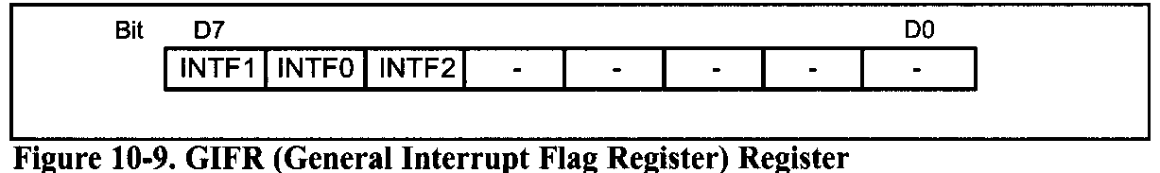
AVR INTERRUPT PROGRAMMING In ASSEMBLY AND C 10.3 PROGRAMMING EXTERNAL HARDWARE INTERRUPTS
Sampling the edge-triggered and level-triggered interrupts
Examine Figure 10-9. The edge interrupt (the falling edge, the rising edge, or the change level) is latched by the AVR and is held by the INTFx bits of the GIFR register.
If the interrupt is active (the INTx bit is set and the I-bit in SREG is one), the AVR will jump to the corresponding interrupt vector location and the INTFx flag will be cleared automatically, otherwise the flag remains set. The flag can be cleared by writing a one to it.
Notes:
the flag remains set. The flag can be cleared by writing a one to it.

Slide 40
AVR INTERRUPT PROGRAMMING In ASSEMBLY AND C 10.3 PROGRAMMING EXTERNAL HARDWARE INTERRUPTS
Notice that in edge-triggered interrupts (falling edge, rising edge, and change level interrupts), the pulse must last at least 1 instruction cycle to ensure that the transition is seen by the microcontroller.
When an external interrupt is in level-triggered mode, the interrupt is not latched, meaning that the INTFx flag remains unchanged when an interrupt occurs, and the state of the pin is read directly.
As a result, when an interrupt is in level-triggered mode, the pin must be held low for a minimum time of 5 machine cycles to be recognized.

Slide 41
AVR INTERRUPT PROGRAMMING In ASSEMBLY AND C 10.4 INTERRUPT PRIORITY IN THE AVR
Interrupt priority
The interrupt with the higher priority is served first. The priority of each interrupt is related to the address of that interrupt in the interrupt vector. The interrupt that has a lower address, has a higher priority.
For example, the address of external interrupt 0 is 0x0002, while the address of external interrupt 2 is 0x0006; thus, external interrupt 0 has a higher priority.

Slide 42
AVR INTERRUPT PROGRAMMING In ASSEMBLY AND C 10.4 INTERRUPT PRIORITY IN THE AVR
Interrupt inside an interrupt
What happens if the AVR is executing an ISR belonging to an interrupt and another interrupt is activated?
When the AVR begins to execute an ISR, it disables the I bit of the SREG register, causing all the interrupts to be disabled, and no other interrupt occurs while serving the interrupt.
When the RETI instruction is executed, the AVR enables the I bit, causing the other interrupts to be served

Slide 43
AVR INTERRUPT PROGRAMMING In ASSEMBLY AND C 10.4 INTERRUPT PRIORITY IN THE AVR
Context saving in task switching
In multitasking systems, such as multitasking Real-Time Operating Systems (RTOS), the CPU serves one task (job or process) at a time and then moves to the next one. In simple systems, the tasks can be organized as the interrupt service routine. For example, in Example 10-3, the program does two different tasks:
copying the contents of PORTC to PORTD,
toggling PORTB.2 every 5 μs
While writing a program for a multitasking system, we should manage the resources carefully so that the tasks do not conflict with each other.
For example, consider a system that should perform the following tasks:
increasing the contents of PORTC continuously, and
increasing the content of PORTB once every 5 μs.

Slide 44
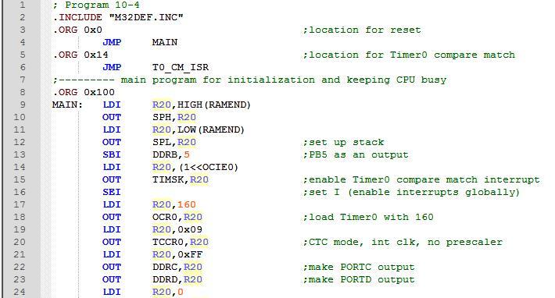
AVR INTERRUPT PROGRAMMING In ASSEMBLY AND C 10.4 INTERRUPT PRIORITY IN THE AVR
Read the following program. Does it work?

Slide 45
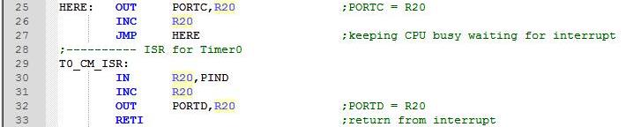
AVR INTERRUPT PROGRAMMING In ASSEMBLY AND C 10.4 INTERRUPT PRIORITY IN THE AVR
The task do not work properly, since they have resource conflict and they interfere with each other.
R20 is used by both tasks, which causes the program not to work properly.

Slide 46

AVR INTERRUPT PROGRAMMING In ASSEMBLY AND C 10.4 INTERRUPT PRIORITY IN THE AVR
We can solve such problems in the following two ways:
Using different registers for different tasks. If we use different registers in the main program and in the ISR, the program will work properly.
Context saving. In big programs we might not have enough registers to use separate registers for different tasks. In these cases, we can save the contents of registers on the stack before execution of each task, and reload the registers at the end of the task. This saving of the CPU contents before switching to a new task is called context saving (or context switching).

Slide 47
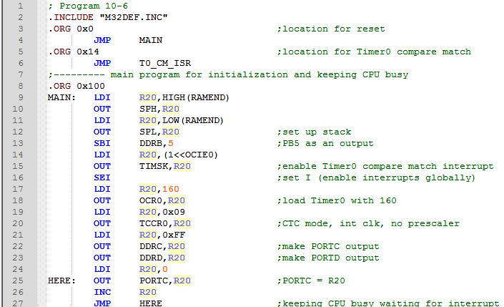
AVR INTERRUPT PROGRAMMING In ASSEMBLY AND C 10.4 INTERRUPT PRIORITY IN THE AVR

Slide 48
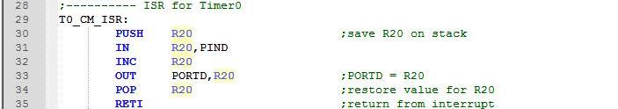
AVR INTERRUPT PROGRAMMING In ASSEMBLY AND C 10.4 INTERRUPT PRIORITY IN THE AVR
Notice that using the stack as a place to save the CPU’s contents is tedious, time consuming, and slow. So we might want to use the first solution, whenever we have enough registers.

Slide 49
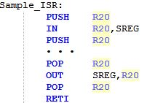
AVR INTERRUPT PROGRAMMING In ASSEMBLY AND C 10.4 INTERRUPT PRIORITY IN THE AVR
Saving flags of SREG register
The flags of SREG are important especially when there are conditional jumps in our program. We should save the SREG register if the flags are changed in a task.
Notes:
The duration of an interrupt latency can be affected by the type of instruction that the CPU is executing when the interrupt comes in, since the CPU finishes the execution of the current instruction before it serves the interrupt. It takes slightly longer in cases where the instruction being executed lasts for two (or more) machine cycles (e.g., MUL) compared to the instructions that last for only one instruction cycle (e.g., ADD). See the AVR datasheet for the timing.

Slide 50
AVR INTERRUPT PROGRAMMING In ASSEMBLY AND C 10.4 INTERRUPT PRIORITY IN THE AVR
Interrupt latency
The time from the moment an interrupt is activated to the moment the CPU starts to execute the task is called the interrupt latency. This latency is 4 machine cycle times. During this time the PC register is pushed on the stack and the I bit of the SREG register clears, causing all the interrupts to be disabled.
The duration of an interrupt latency can be affected by the type of instruction that the CPU is executing when the interrupt comes in, since the CPU finishes the execution of the current instruction before it serves the interrupt. It takes slightly longer in cases where the instruction being executed lasts for two (or more) machine cycles (e.g., MUL) compared to the instructions that last for olny one instruction cycle.
Notes:
The duration of an interrupt latency can be affected by the type of instruction that the CPU is executing when the interrupt comes in, since the CPU finishes the execution of the current instruction before it serves the interrupt. It takes slightly longer in cases where the instruction being executed lasts for two (or more) machine cycles (e.g., MUL) compared to the instructions that last for only one instruction cycle (e.g., ADD). See the AVR datasheet for the timing.

Slide 51
AVR INTERRUPT PROGRAMMING In ASSEMBLY AND C 10.5 INTERRUPT PROGRAMMING IN C
In C language there is no instruction to manage the interrupts. So, in WinAVR the following have been added to manage the interrupts:
Interrupt include file: We should include the interrupt header file if we want to use interrupts in our program. Use the following instruction:
#include <avr\interrupt.h>
cli ( ) and sei ( ) : In Assembly, the CLI and SEI instructions clear and set the I bit of the SREG register, respectively. In WinAVR, the cli ( ) and sei ( ) macros do the same tasks.

Slide 52
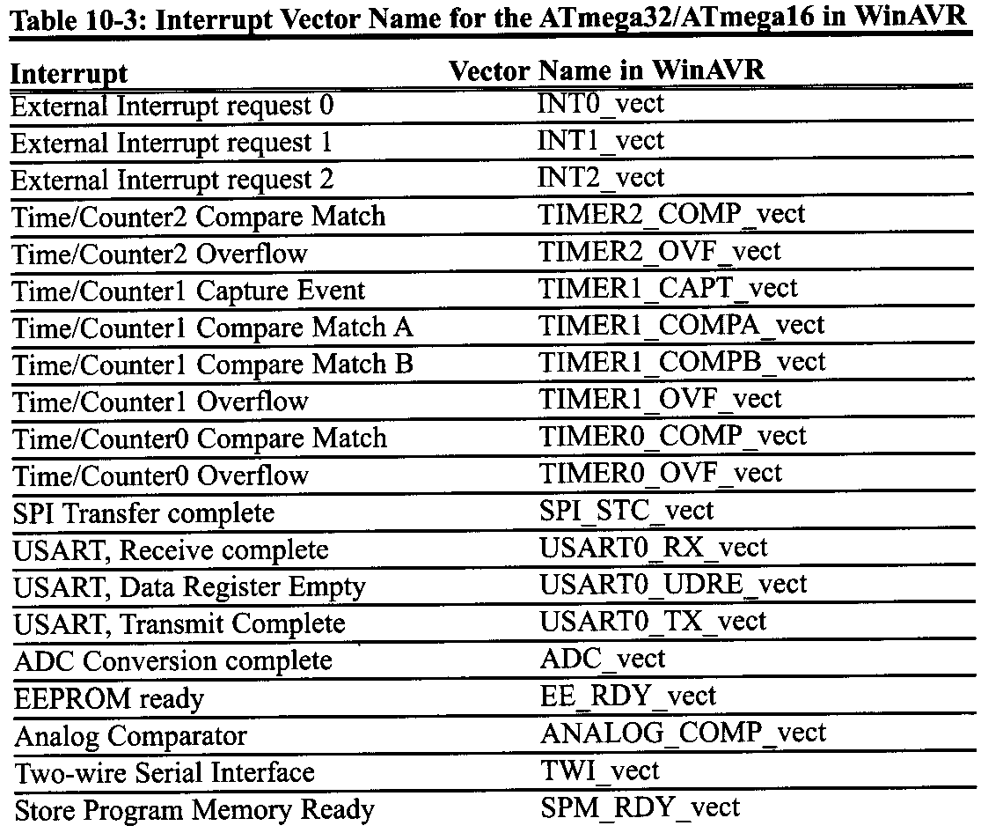
AVR INTERRUPT PROGRAMMING In ASSEMBLY AND C 10.5 INTERRUPT PROGRAMMING IN C

Slide 53
AVR INTERRUPT PROGRAMMING In ASSEMBLY AND C 10.5 INTERRUPT PROGRAMMING IN C
Defining ISR: To write an ISR (interrupt service routine) for an interrupt we use the following structure:
ISR(interrupt vector name)
{
//our program
}
For the interrupt vector name we must use the ISR names in Table 10-3. For example, the following ISR serves the Timer0 compare match interrupt:
ISR (TIMER0_COMP_vect)
{
}

Slide 54
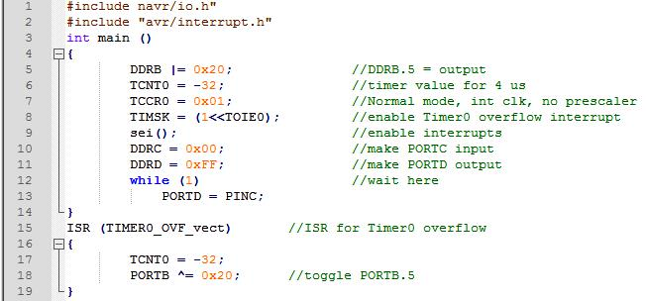
AVR INTERRUPT PROGRAMMING In ASSEMBLY AND C 10.5 INTERRUPT PROGRAMMING IN C
Example 10-8 (C version of program 10-1)
Using Timer0 generate a square wave on pin PORTB.5, while at the time transferring data from PORTC to PORTD.
Solution:

Slide 55
AVR INTERRUPT PROGRAMMING In ASSEMBLY AND C 10.5 INTERRUPT PROGRAMMING IN C
Context saving
The C compiler automatically adds instructions to the beginning of the ISRs, which save the contents of all of the general purpose registers and the SREG register on the stack. Some instructions are also added to the end of the ISRs to reload the registers.

Slide 56
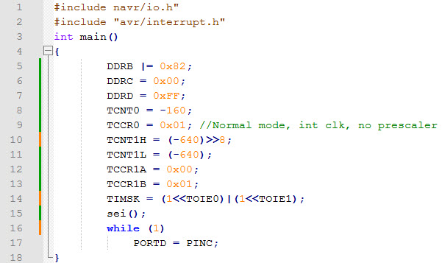
AVR INTERRUPT PROGRAMMING In ASSEMBLY AND C 10.5 INTERRUPT PROGRAMMING IN C
Example 10-9 (C version of Program 10-2)
Using Timer0 and Timer1 interrupts, generate square waves on pins PB1 and PB7 respectively, while transferring from PORTC to PORTD.

Slide 57
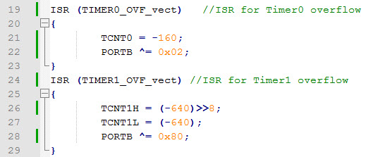
AVR INTERRUPT PROGRAMMING In ASSEMBLY AND C 10.5 INTERRUPT PROGRAMMING IN C
Note: We can use "TCNT1 = -640;" in place of the following instructions:
TCNT1H = (-640)>>8;
TCNT1L = (-640) ;

Slide 58
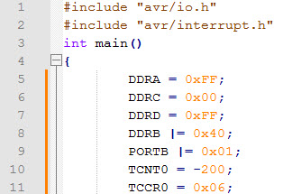
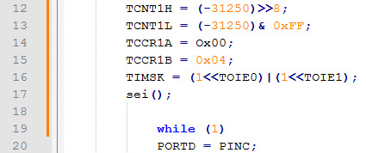
AVR INTERRUPT PROGRAMMING In ASSEMBLY AND C 10.5 INTERRUPT PROGRAMMING IN C
Example 10-10 (C version of program 10-3)
Using Timer0 and Timer1 interrupts, write a program in which:
(a) PORTA counts up every time Timer1 overflows. It overflows once per second.
(b) A pulse is fed into Time0 where Timer0 is used as counter and counts up. whenever the counter reaches 200, it will toggle the pin PORTB.6.

Slide 59
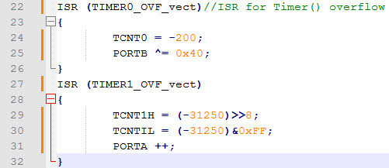
AVR INTERRUPT PROGRAMMING In ASSEMBLY AND C 10.5 INTERRUPT PROGRAMMING IN C
Example 10-10 (C version of program 10-3)

Slide 60
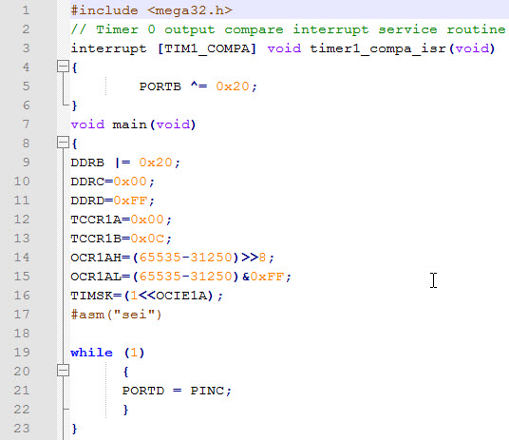
AVR INTERRUPT PROGRAMMING In ASSEMBLY AND C 10.5 INTERRUPT PROGRAMMING IN C
Example 10-11 (C version of program 10-4)
Using Timer1, write a program that toggles pin PORTB.5 every second, while at the same time transferring data from PORTC to PORTD. Assume XTAL = 8 MHz.

Slide 61
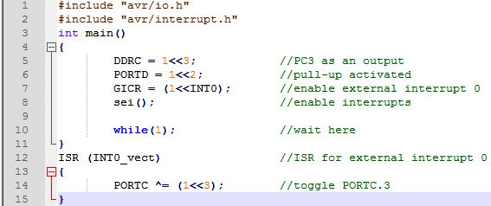
AVR INTERRUPT PROGRAMMING In ASSEMBLY AND C 10.5 INTERRUPT PROGRAMMING IN C
Example 10-12 (C version of program 10-5)
Assume that the INT0 pin is connected to a switch that is normally high. write a program that toggles PORTB.3, whenever INT0 pin goes low. Use the external interrupt in level-triggered mode.

Slide 62
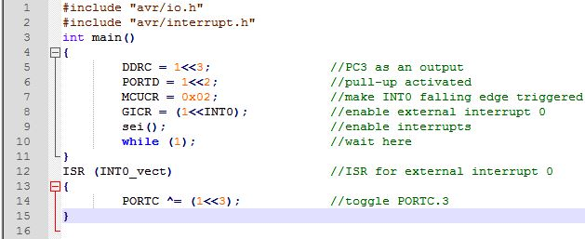
AVR INTERRUPT PROGRAMMING In ASSEMBLY AND C 10.5 INTERRUPT PROGRAMMING IN C
Example 10-13 (C version of program 10-7)
Rewrite Example 10-12 so that whenever INT0 goes low, it toggles PORTC.3 only once.

